Slide 1
CLAS 220 Introduction to Classical Mythology
Homer, Odyssey 7-12

Slide 2
Quiz Question
What is the name of the king of the Phaiakians?
Alkinoos
Arete
Nausikaa
Polyphemus

Slide 3
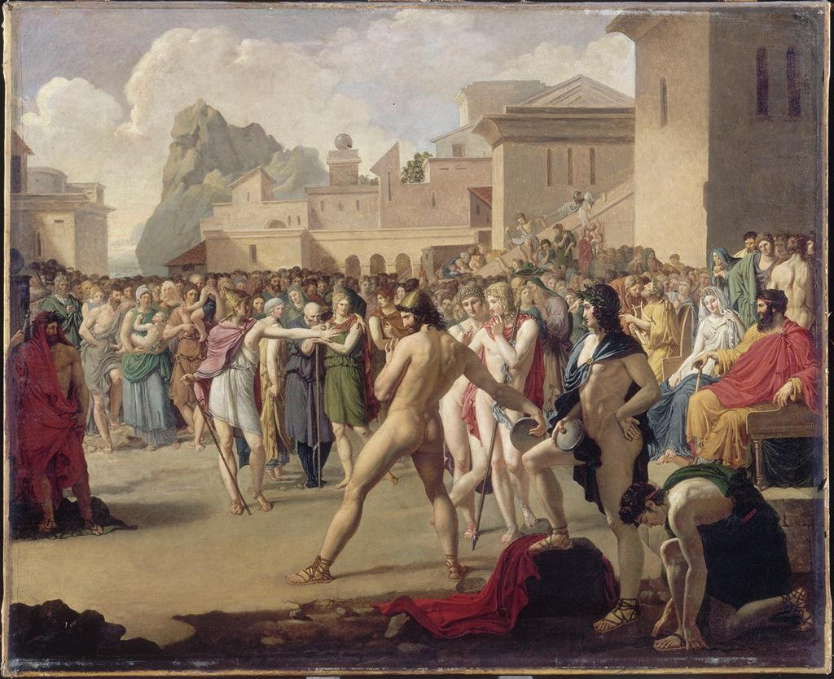
The isle of the Phaiakians
For we, too, have our skills, given by Zeus,
And practiced from our father’s time to this –
Not in the boxing ring nor the palestra
Conspicuous, but in racing, land or sea;
And all our days we set great store by feasting,
Harpers, and the grace of dancing choirs,
Changes of dress, warm baths, and downy beds.
8.257-263

Slide 4
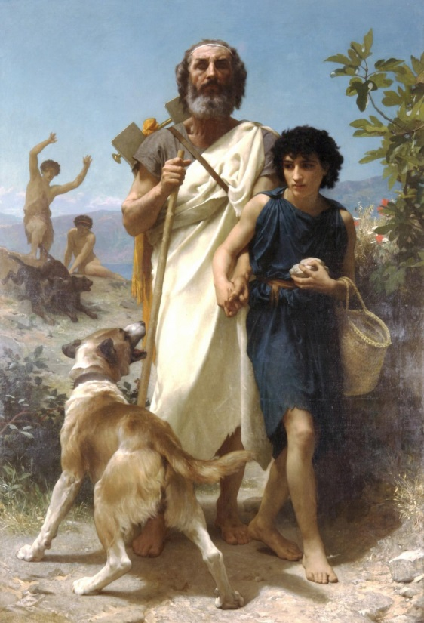
The songs of Demodokos (I)
… the clash between Odysseus and Akhilleus,
How one time they contended at the godfeast
Raging, and the marshal, Agamemnon,
Felt inward joy over his captains’ quarrel;
For such had been foretold him by Apollo
At Pytho – hallowed height – when the Akhaian
Crossed that portal of rock to ask a sign…
So ran the tale the minstrel sang. Odysseus
With massive hand drew his rich mantle down
Over his brow, cloaking his face with it,
To make the Phaiakians miss the secret tears
That started to his eyes…
8. 81-94

Slide 5
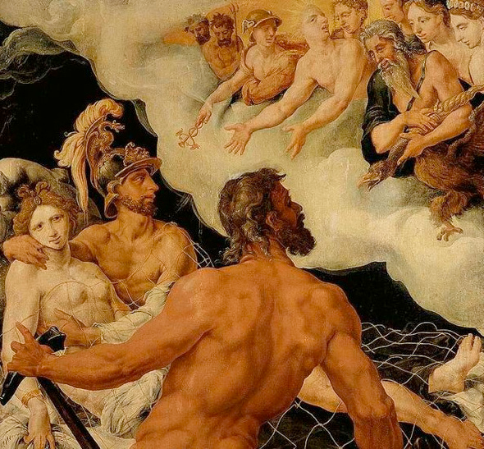
The songs of Demodokos (II)
Now to his harp the blinded minstrel sang
Of Ares’ dalliance with Aphrodite:
How hidden in Hephaistos’ house they played
At love together, and the gifts of Ares,
Dishonoring Hephaistos’ bed…
And when he learned it, Lord Hephaistos went
With baleful calculation to his forge.
There mightily he armed his anvil block
And hammered out a chain whose tempered links
Could not be sprung or bent…
8.280-291

Slide 6
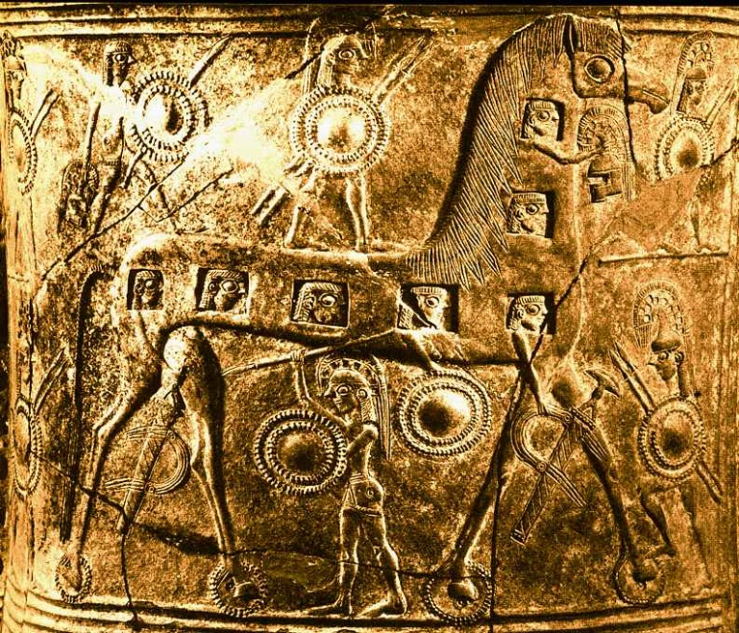
The songs of Demodokos (III)
He sang, then, of the town sacked by Akhaians
Pouring down from the horse’s hollow cave,
This way and that way raping the steep city,
And how Odysseus came like Ares to
The door of Deiphobos, with Menelaos,
And braved the desperate fight there –
Conquering once more by Athena’s power.
The splendid minstrel sang it.
8. 552-559

Slide 7
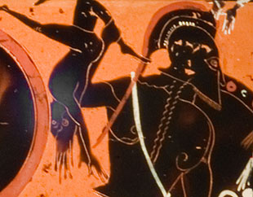
Odysseus responds
.. . And Odysseus
Let the bright molten tears run down his cheeks,
Weeping the way a wife mourns for her lord
On the lost field where he has gone down fighting
The day of wrath that came upon his children
At sight of the man panting and dying there,
She slips down to enfold him, crying out;
Then feels the spears, prodding her back and shoulders,
And goes bound into slavery and grief.
Piteous weeping wears away her cheeks:
But no more piteous than Odysseus’ tears…
8. 560-570

Slide 8
Quiz Question
2. Who is the father to the Cyclops Polyphemus?
Laertes
Zeus
Poseidon
Agamemnon

Slide 9
Odysseus’ Adventures (Part I)
Akhilleus had to choose between kleos and nostos
For Odysseus, his kleos IS his nostos
These books are about moving towards that nostos, and about the alternatives to it
Other kinds of lives that Odysseus might have
How to make the nostos real

Slide 10
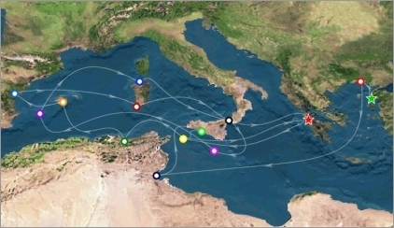
Odysseus’ Adventures

Slide 11
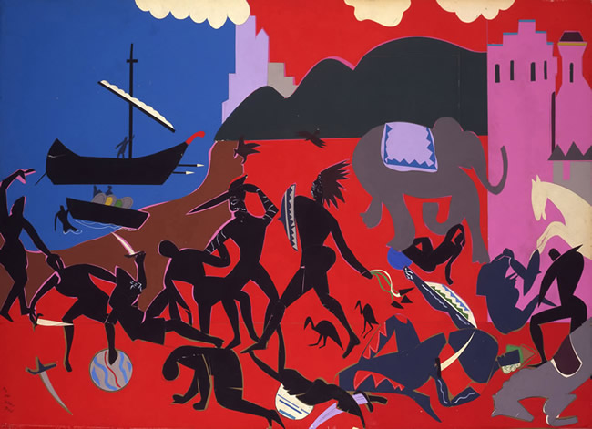
Kikones
I stormed that place and killed the men who fought,
Plunder we took, and we enslaved the women,
To make division, equal shares to all –
But on the spot I told them: “Back, and quickly!
Out to sea again!” My men were mutinous,
Fools, on stores of wine….
9. 46-52

Slide 12
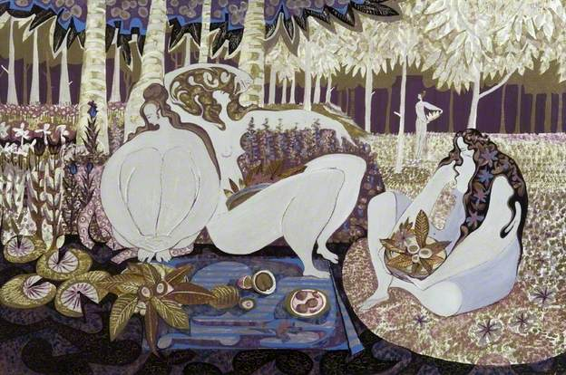
The Lotus-Eaters
They fell in, soon enough, with Lotos Eaters,
Who showed no will to do us harm, only
Offering the sweet Lotos to our friends –
But those who ate this honeyed plant, the Lotos,
Never cared to report, nor to return:
They longed to stay forever, browsing on
That native bloom, forgetful of their homeland.
9. 98-104

Slide 13
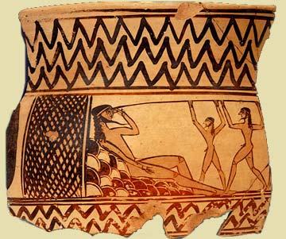
The Cyclops
The ultimate in bad hosts
Odysseus also a bad guest here
Also the opposite of civilized:
Eats raw (human) flesh
Drinks unmixed wine
No agriculture
No cities

Slide 14
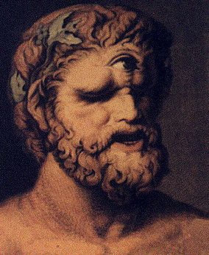
Nohbdy
“My name is Nohbdy: mother, father, and friends,
Everyone calls me Nohbdy.” And he said,
“Nohbdy’s my meat, then, after I eat his friends.
Others come first. There’s a noble gift, now.”
9. 398-401
“Kyklops,
If ever mortal man inquire
How you were put to shame and blinded, tell him
Odysseus, raider of cities, took your eye:
Laertes’ son, whose home’s on Ithaka!”
9. 549-553
Ou tis = no one
two negatives in Greek: ou, mê
so sometimes also mê tis = mêtis (cunning)

Slide 15
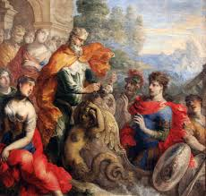
Island of Aiolos
The sight amazed them, and they all exclaimed:
“Why back again, Odysseus? What sea fiend
Rose in your path? Did we not launch you well
For home, or for whatever land you chose?”
Out of my melancholy, I replied:
“Mischief aboard, and nodding at the tiller –
A damned drowse – did for me. Make good my loss,
Dear friends! You have the power!” Gently I pleaded,
But they turned cold and still. Said Father Aiolos:
“Take yourself out of this island, creeping thing –
No law, no wisdom, lays it on me now
To help a man the blessed gods detest –
Out! Your voyage here was cursed by heaven!”
10.71-85

Slide 16
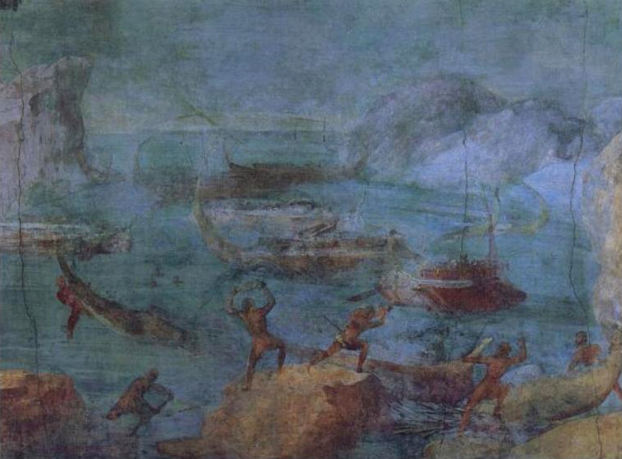
The Laistrygonians
A stalwart young girl taking her pail to Artakia,
The fountain where these people go for water.
My fellows hailed her, put their questions to her:
who might the king be, ruling over whom?
She waved her hand, showing her father’s lodge:
So they approached it. In the gloom they saw
A woman like a mountain crag, the queen –
And loathed the sight of her. But she, for greeting,
Called from the meeting ground her lord and master,
Antiphates, who came to drink their blood.
10. 118-128

Slide 17
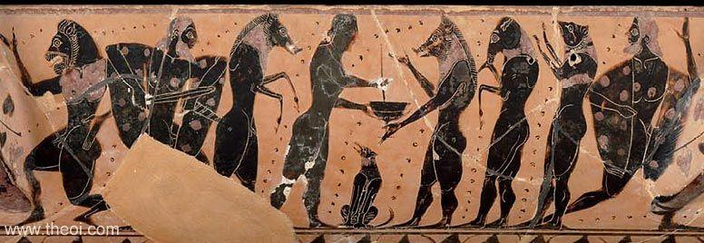
Circe’s Island
On thrones she seated them, and lounging chairs,
While she prepared a meal of cheese and barley
And amber honey mixed with Pramnian wine,
Adding her own vile pinch, to make them lose
Desire or thought of their own dear father land.
Scarce had they drunk when she flew after them
With her long stick and shut them in a pigsty –
Bodies, voices, heads and bristles, all
Swinish now, though minds were still unchanged.
So, squealing, in they went. And Kirke tossed them
Acorns, mast, and cornel berries – fodder
For hogs who rut and slumber on the earth.
10.249-68

Slide 18
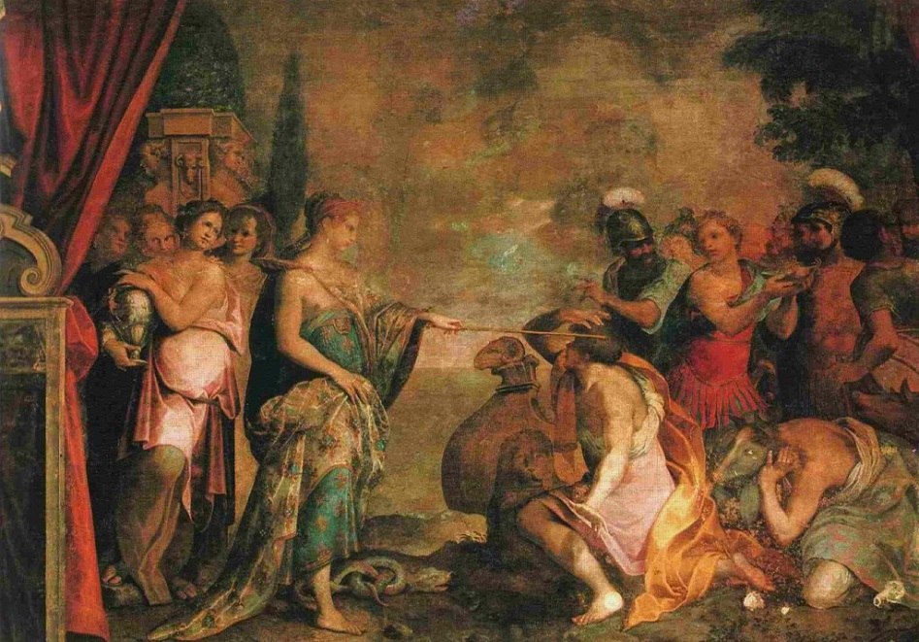
Circe’s advice
“Son of Laertes and the gods of old,
Odysseus, master mariner and soldier,
You shall not stay here longer against your will;
But home you may not go
Unless you take a strange way round and come
To the cold homes of Death and pale Persephone.
You shall hear prophecy from the rapt shade
Of Teiresias of Thebes, forever
Charged with reason even among the dead;
To him alone, of all the flitting ghosts,
Persephone has given a mind undarkened.”
10. 540-550

Slide 19
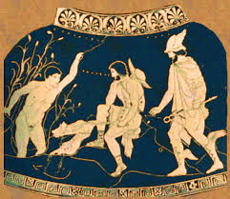
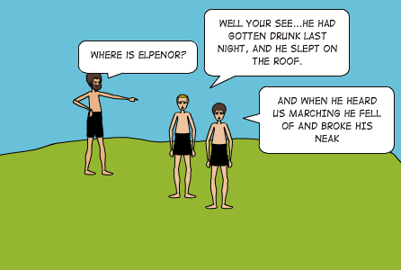
The Death of Elpenor
The youngest was Elpenor –
No mainstay in a fight nor very clever –
And this one, having climbed on Kirke’s roof
To taste the cool night, fell asleep with wine.
Waked by our morning voices, and the tramp
Of men below, he started up, but missed
His footing on the long steep backward ladder
And fell that height headlong. The blow smashed
The nape cord, and his ghost fled to the dark.
10. 610-618

Slide 20
Quiz Question
3. Who refuses to speak to Odysseus in the underworld? a. Achilles
b. Agamemnon
c. Ajax
d. His mother

Slide 21
Quiz Question
4. Who is punished in the underworld by being required to roll a rock uphill forever?
Tantalus
Ixion
Arethusa
Sisyphus

Slide 22
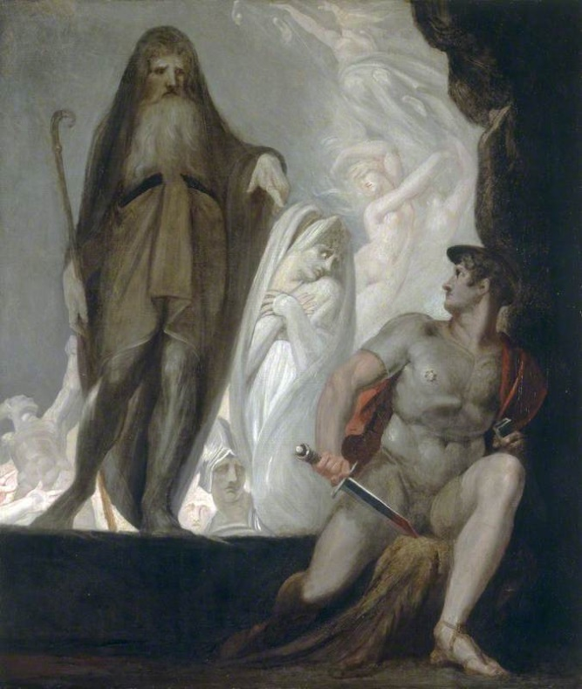
The Descent to the Underworld
In theory, so that Odysseus can consult Teiresias
BUT:
Kirke gives him the same advice anyway
that advice goes ignored
other motivations for the journey:
opportunity for Odyssey to tell other parts of Epic Cycle
opportunity to discuss other mythic narratives
chance to finish "unfinished business" of the Iliad

Slide 23

Underworld: Elpenor
“When you make sail
And put these lodgings of dim Death behind,
You will moor ship, I know, on Aiaia Island;
There, O my lord, remember me, I pray,
Do not abandon me unwept, unburied,
To tempt the gods’ wrath, while you sail for home;
But fire my corpse, and all the gear I had,
And build a cairn for me above the breakers –
An unknown sailor’s mark for men to come.
Heap up the mound there, and implant upon it
The oar I pulled in life with my companions.”
11. 77-88

Slide 24
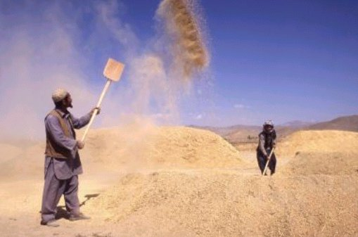
Underworld: Teiresias
Avoid those kine! ….
But after you have dealt out death – in open
Combat or by stealth – to all the suitors,
Go overland on foot, and take an oar,
Until one day you come where men have lived
With meat unsalted, never known the sea,
Nor seen seagoing ships, with crimson bows
And oars that fledge light hulls for dipping flight.
The spot will soon be plain to you, and I
Can tell you how: some passerby will say,
“What winnowing fan is that upon you shoulder?”
Halt, and implant your smooth oar in the turf
And make fair sacrifice to Lord Poseidon:
A ram, a bull, a great buck boar; turn back,
And carry out pure hekatombs at home
To all wide heaven’s lords, the undying gods,
To each in order. Then a seaborne death
Soft as the hand of mist will come upon you
When you are wearied out with rich old age,
Your country folk in blessed peace around you.
11.133-52

Slide 25
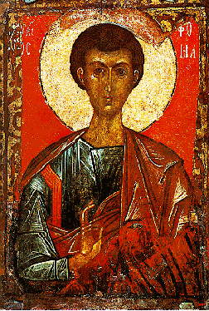
A Greek folktale: early 20th century
The Prophet Elias was a fisherman who, because of terrible weather and terrific storms, became afraid of the sea. So he put an oar on his shoulder and took to the hills. When he met a man, he asked him what it was he was carrying; the man answered that it was an oar, and Elias went on. The same happened when he met a second man. But at the top of a mountain, he asked a third man, who replied, 'why, that's a stick'. Saint Elias resolved to stay there. He planted his oar in the ground, and that is why his chapels are all built on hilltops.

Slide 26
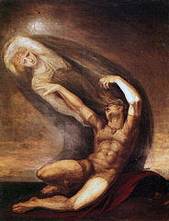
Underworld: Antikleia
“Any dead man
Whom you allow to enter where the blood is
Will speak to you, and speak the truth; but those
Deprived will grow remote again and fade.”
…. “I bit my lip,
Rising perplexed, with longing to embrace her,
And tried three times, putting my arms around her,
But she went sifting through my hands, impalpable
As shadows are, and wavering like a dream.”
11. 163-66; 228-232

Slide 27
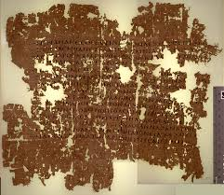
Underworld: Catalogue of Mothers
convention in Greek literature of "doing" genealogy of heroes through the female line
connects local families of heroes to larger networks
Hesiod's Catalogue of Women
allows the Odyssey to connect itself to other mythical traditions
Theban Cycle (including Oedipus)
Calydonian Boar Hunt
Argonauts
Nestor's cattle-raiding past

Slide 28
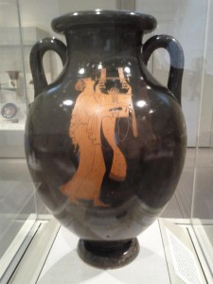
Odysseus pauses his story
… but how name all the women I beheld there,
Daughters and wives of kings? The starry night
Wanes long before I close. Here, or aboard ship,
Amid the crew, the hour for sleep has come…
11. 381-384

Slide 29
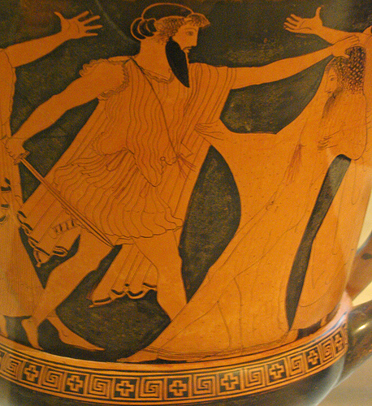
Underworld: Agamemnon
Let it be a warning
Even to you. Indulge a woman never,
And never tell her all you know. Some things
A man may tell, some he should cover up.
Not that I see a risk for you, Odysseus,
Of death at your wife’s hands. She is too wise,
Too clear-eyed, sees alternatives too well…
11. 513-520

Slide 30
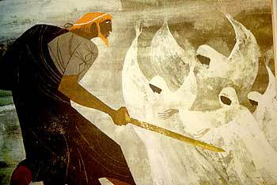
Underworld: Achilles
Better, I say, to break sod as a farm hand
For some poor country man, on iron rations,
Than lord it over all the exhausted dead.
11. 579-581

Slide 31
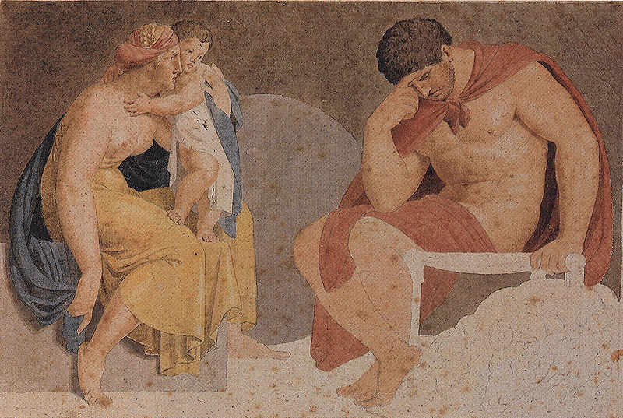
Underworld: Ajax
“My lord, come nearer, listen to our story!
Conquer your indignation and your pride.”
But he gave no reply, and turned away,
Following other ghosts towards Erebos.
11.669-672

Slide 32
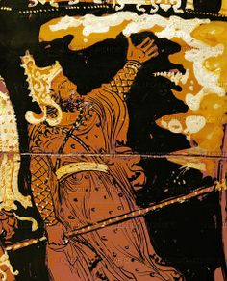
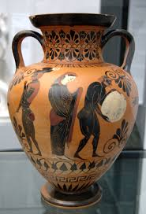
Underworld: Tantalos and Sisyphus

Slide 33
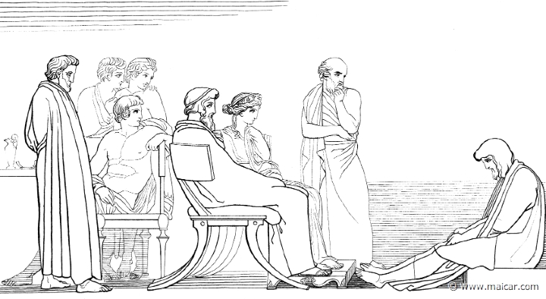
Odysseus’ Adventures (II)
Odysseus resumes the story of his
adventures, describing the events
from his return from the underworld
to his arrival on the island of Kalypso.
He then concludes his story, saying
"why repeat himself" (though he hasn't actually told us anything about his time with Kalypso)
The Phaiakians prepare to send him home.

Slide 34
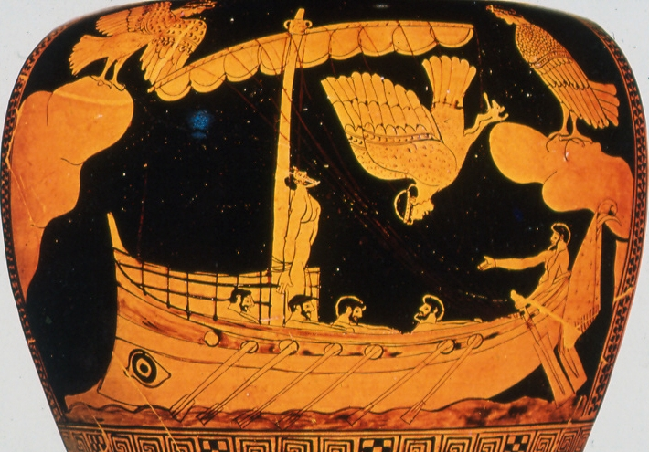
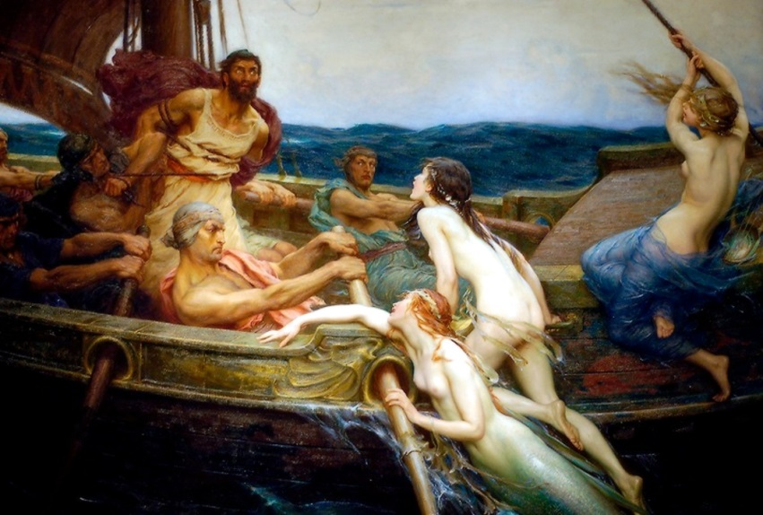
Sirens
Sea rovers here take joy
voyaging onward,
As from our song of Troy
Greybeard and rower-boy
goeth more learned.
All feats on that great field
in the long warfare,
Dark days the bright gods willed,
wounds you bore there,
Argos’ old soldiery
On Troy beach teeming,
Charmed out of time we see.
No life on earth can be
Hid from our dreaming.
12.233-245

Slide 35
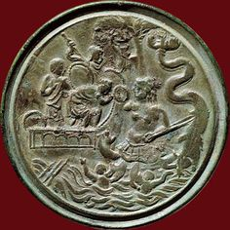
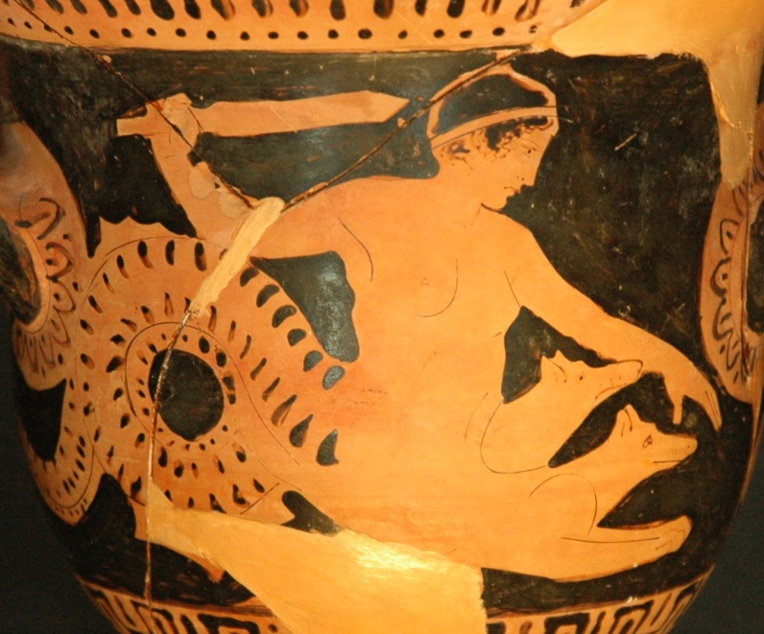
Scylla and Charybdis

Slide 36

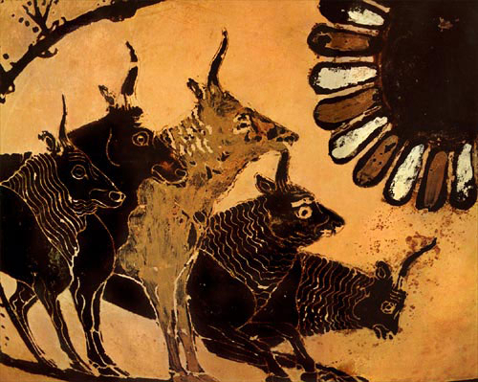
The Oxen of the Sun
No more seafaring
Homeward for these, no sweet day of return;
The god had turned his face from them.
12. 532-534

Slide 37
Quiz Question
5. How many of Odysseus’ crew make it home with him?
Ten
Five
Three
None

